Slide 1

“Topology in Condensed Matter and High Energy Physics”, Croucher Advanced Study Institute,
The Chinese University of Hong Kong, Jan. 3-5, 2018
Quantum Anomalous Hall Effect and Majorana Fermion
Qi-Kun Xue
Department of Physics
Tsinghua University (清华大学)

Slide 2
OUTLINE
Introduction
MBE growth of topological insulators
Quantum Anomalous Hall Effect
New developments and summary

Slide 3
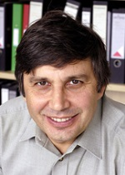
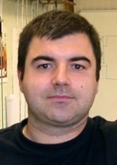
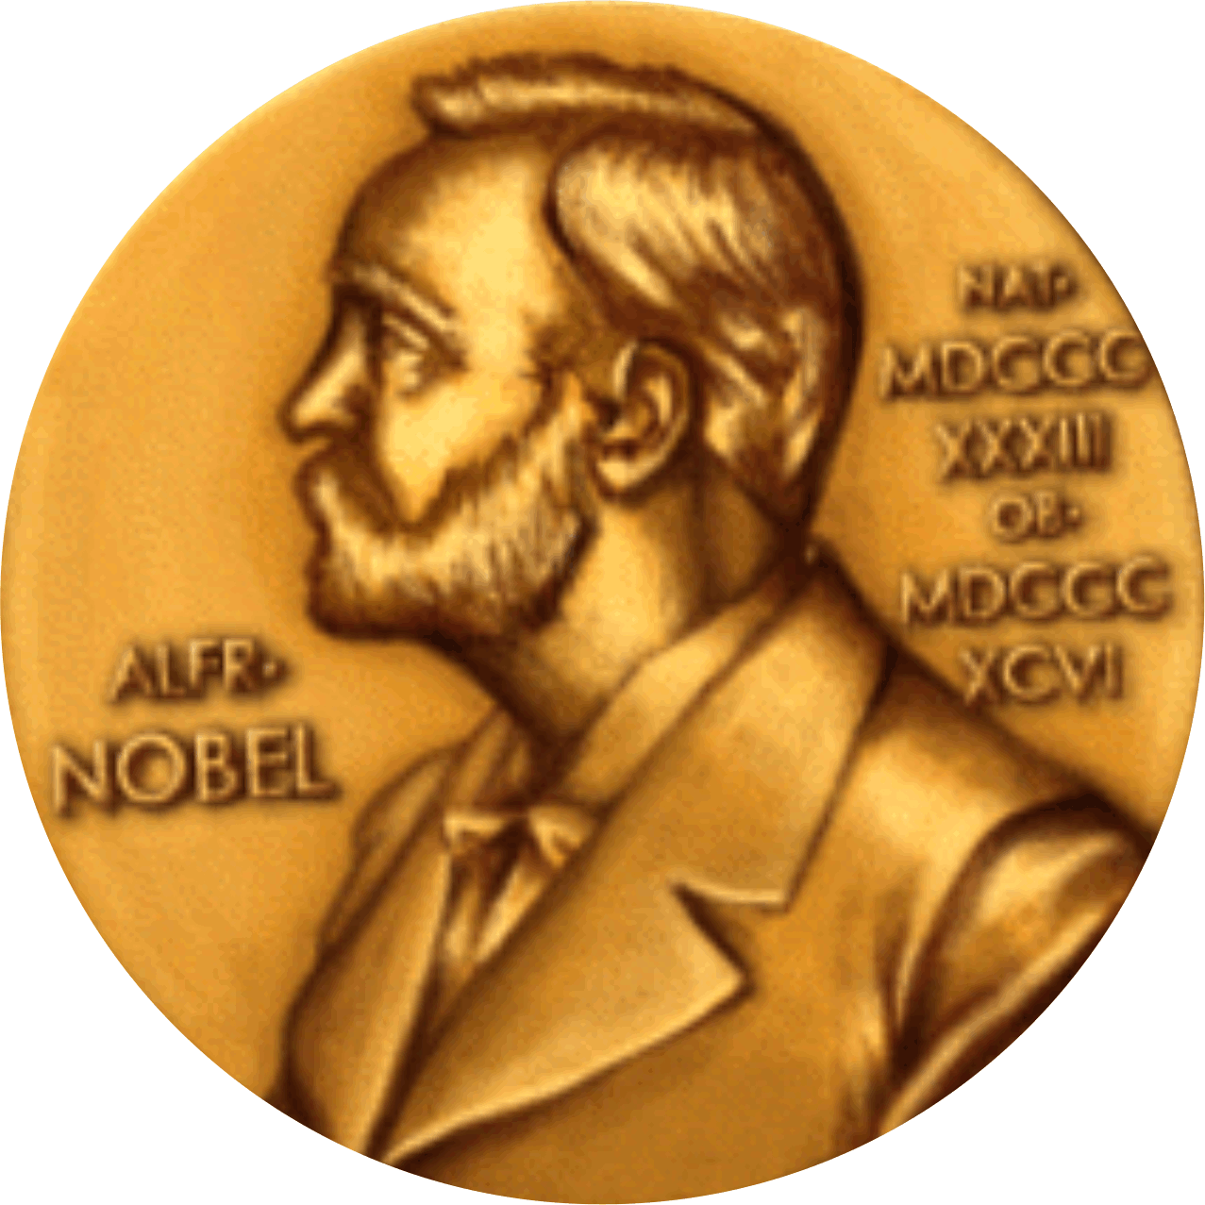
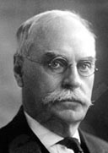
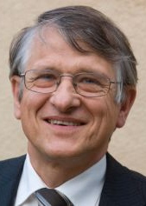
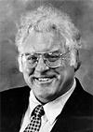
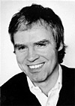
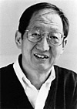
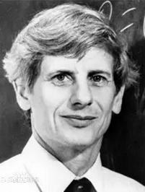
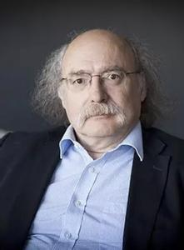
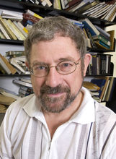
R_{H}
R_{H}
R_{H}
h/e²
h/2e²
R_{H}=3h/e²
Half-integer
QHE
(graphene)
FQHE
(GaAs)
H
H
H
Hall Effect
Anomalous HE
IQHE (Si)
TPM
IQHE
FQHE
1879
1881
1980
1982
1983
2005
2010
1985
1998
Quantization of AHE?
E. Hall
K. von Klitzing
B. Laughlin
H. Stormer
D. Tsui
D. Thouless
F. Haldane
J. Kosterlitz
2016
Topological Phase Transitions and Topological Phases of Matter

Slide 4
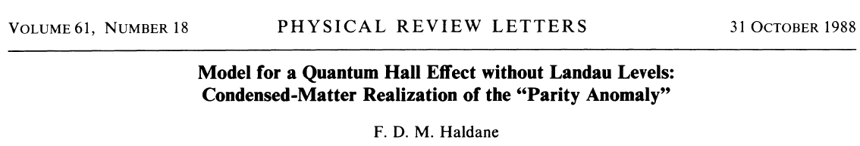
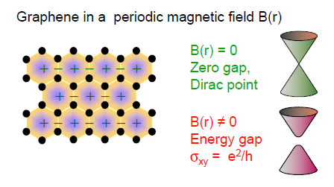
The first Theoretical Proposal for Quantum Hall Effect
without Magnetic Field
Graphene with broken TRS
Page 2018:
While the particular model presented here is unlikely to be directly physically realizable, at least in principle, QHE does not necessarily require external magnetic fields……
Science 329, 61 (2010).

Slide 5
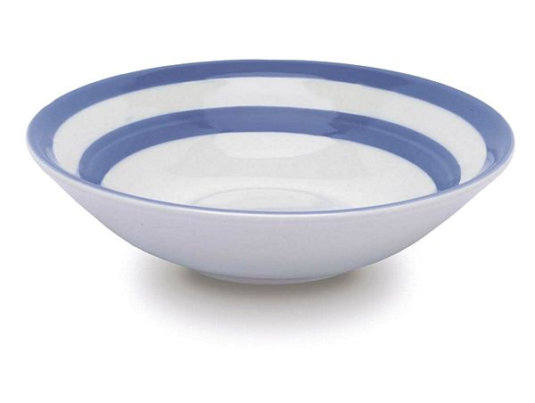
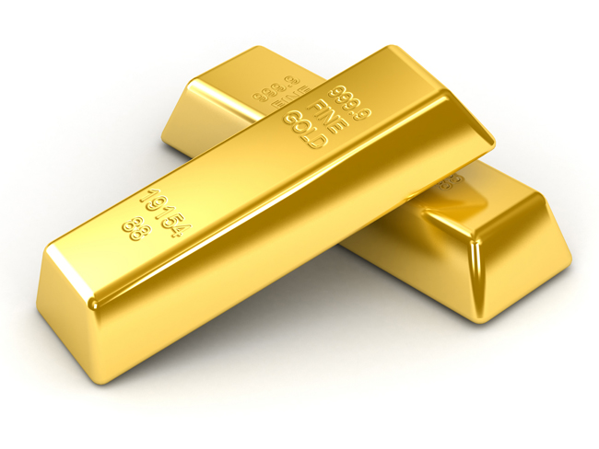
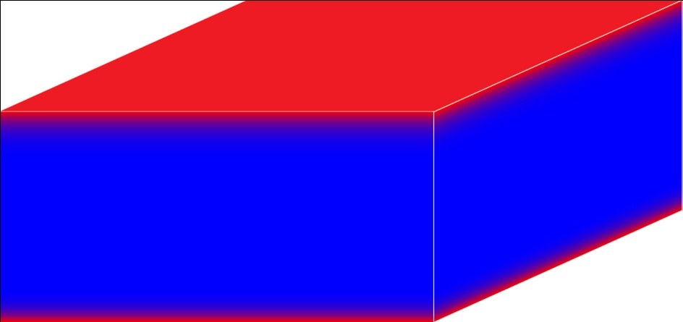
Classification of a Material (new)
Topological
Conductor
Insulator
Insulator
conducting (surface)
Spin-Orbital Coupling
Insulating (bulk)
Notes:
We started this study last year. By standard MBE film growth technique, we could prepare TI films with LBL thickness control.

Slide 6
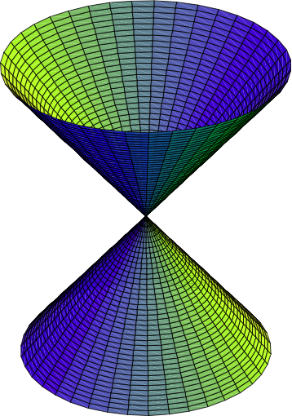
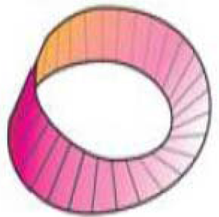
Ordinary versus Topological Insulators
Ordinary Insulator
Topological Insulator
Conduction Band
Conduction Band
Strong spin-orbit coupling
(m=0)
Spin up
“band twisting”
Spin down
E
Valence Band
Valence Band
k_{x}
k_{y}
Rashba Spin-Orbit Splitting of Surface States
Time reversal symmetry, Strong S-O coupling
Notes:
Let’s first talk about TI. In this slide, I show you the difference between ordinary insulator and topological insulator. This is the band structure of a normal insulator, the valence band, the conduction band, and the energy gap between. If the gap is not large, and the spin-orbital coupling in the material is very strong, then there will be a band twisting. The band twisting produces linearly dispersed and spin-polarized bands within the gap. The states are very robust unless the time-reversal symmetry of the system is broken because of the Kramers degeneracy.
Therefore, the band topology is very different.
In real space, TI can be regarded as a bulk-insulating narrow-band semiconductor with metallic states on its surface or boundary.

Slide 7
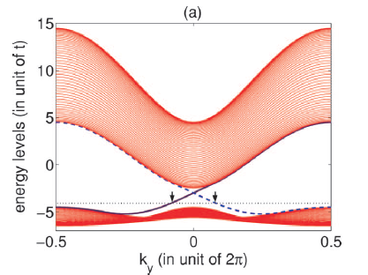
Theories for QHE without a magnetic field
“Quantum Anomalous Hall Effect” by Naoto Nagaosa
QAH
Spin-orbital coupling + magnetism
X. L. Qi, Y. S. Wu, S. C. Zhang, PRB 74, 085308 (2006)
Onoda, Sugimoto & Nagaosa, PRL 97, 126602 (2006)
Z. Qiao, Q. Niu et al., PRB 82, 161414(R) (2010)……
Notes:
A question is that is it possible to realize QHE without magnetic field. Or in other words, is it possible to find an topological insulator without magnetic field? The answer is yes. In 1988, Haldane propose a mode, which is basically a graphene but with its time reversal symmetry broken somehow. We know the energy band of graphene is a Dirac cone. By breaking its TRS, the Dirac cone will be gapped and become an insulator. Such an insulator is an topological insulator with Chern number of 1. Thus we can observe QHE in this system without Landau levels. It means QHE can appear without magnetic field and high sample mobility, which will be good at application of QHE. Unfortunately, the graphene with broken TRS is difficult to realize. Little progress has been made in this direction.

Slide 8
Theory: making TIs ferro-magnetic
TI/Magnetic layer
X. L. Qi et al., PRB 78, 195424 (2008)
Magnetic doping (Bi₂Se₃/Bi₂Te₃/Sb₂Te₃)
Y. Z. Li et al., Nat. Phys. 6, 284 (2010)
Hg_{1-y}Mn_{y}Te QWs
C. X. Liu et al. PRL101, 146802 (2008)
Magnetic doped Bi₂Se₃ family
R. Yu et al., Science 329, 61 (2010)
M
II
M
3D TI with FM
Thin film with FM
Film edge: topological edge (a domain wall)
Opposite z: different topological number
Gapped Dirac surface state:
a QH insulator: σ_{xy} = 1/2 (e²/h)
SP-ARPES: Δ + z-polarization
S.-Y. Xu et al., Nat. Phys. 2012
Notes:
If we introduce ferromagnetism in a 3D TI, the broken TRS will open a gap at the Dirac surface states. Such a gap-opening was reported in spin-resolved ARPES. The gapped Dirac surface states is actually a QH insulator with half QH conductance. To measure the QH conductance we need to produce an edge. However, the surface states of a 3D TI with closed surface has no edge.
To produce the edge, we just reduce the film thickness. Since the top and bottom surfaces have different topological character, the film edge becomes a topological edge, and carry a full quantum conductance--e²/h.

Slide 9

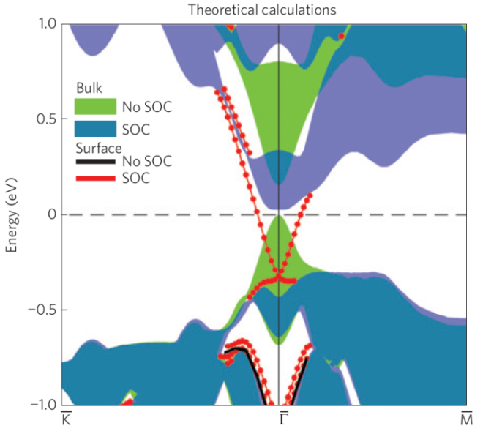
3D Topological Insulators: Bi₂Se₃, Bi₂Te₃, Sb₂Te₃
Sb₂Te₃
Bi₂Te₃
Se
Bi
Bi₂Se₃
300 meV
Bi₂Se₃
Xia et al., Nat. Phys. 5, 398 (2009)
Zhang et al., Nat. Phys. 5, 438 (2009)
Notes:
The experiment in our group was done with 3D TI, BiSe----SbTe, so, today we focus on the three materials, which were first studied by Prof. Zhang and Prof. Hasan’s groups.

Slide 10
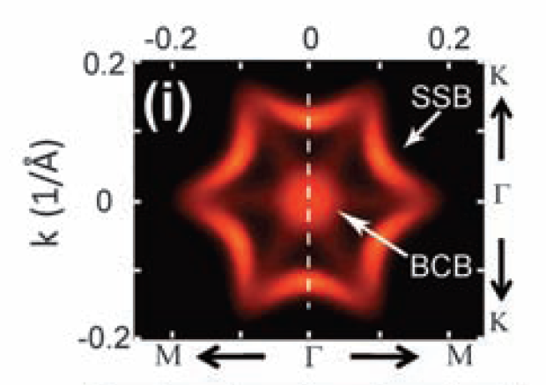
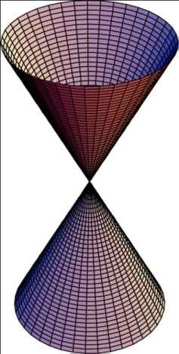
Electron Band Structure of 3D TI by ARPES
Bi₂Te₃
Bi₂Se₃
n-type conductor
(Se vacancies)
(Similar to that in ZnO)
Dirac Cone
Z. X. Shen: Science 2009
Hasan: Nat. Phys. 2009

Slide 11
Topological Insulator Material
“insulator” by definition: Bulk insulating
Surface metallic (2D)
If the bulk is conducting, it is difficult to measure the transport property of its surface with exotic topological property.
bulk
(real space)
High quality:
low defect/impurity density
Notes:
Let’s first talk about TI. In this slide, I show you the difference between ordinary insulator and topological insulator. This is the band structure of a normal insulator, the valence band, the conduction band, and the energy gap between. If the gap is not large, and the spin-orbital coupling in the material is very strong, then there will be a band twisting. The band twisting produces linearly dispersed and spin-polarized bands within the gap. The states are very robust unless the time-reversal symmetry of the system is broken because of the Kramers degeneracy.
Therefore, the band topology is very different.
In real space, TI can be regarded as a bulk-insulating narrow-band semiconductor with metallic states on its surface or boundary.

Slide 12
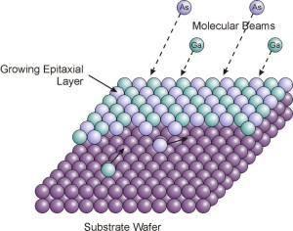
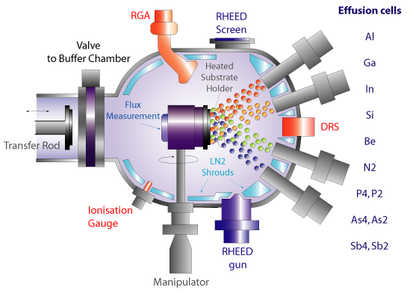
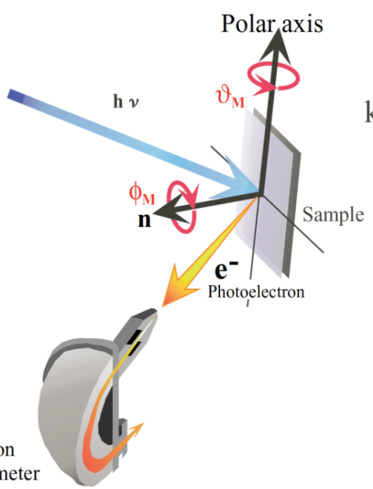
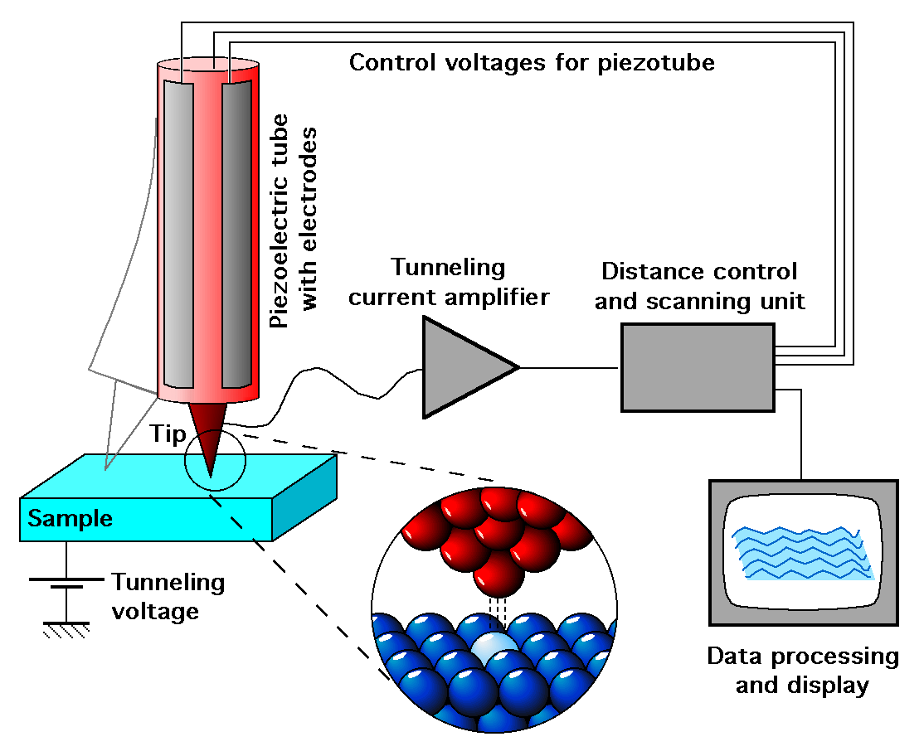
Ultra-High Vacuum Systems
Molecular Beam Epitaxy (MBE) (Cho & Arthur, 1970)
Atomic-Level
Angle-Resolved Photoemission Spectroscopy (ARPES)
Scanning Tunneling Microscope (STM)
(Binnig & Rohrer, 1981)
E_{k} = hυ – W – E (k//)
E_{k} : kinetic energy
hυ : photon energy
W : work function
E(k//): band dispersion
Notes:
Yesterday, we heard of lot of beautiful story about the history of MBE. Particularly from Dr. Cho, a pioneer of MBE, we know that MBE was formally termed in 1970. Everybody here knows well that MBE is one of the most powerful techniques for preparing high quality film materials. If we further combine MBE with STM and ARPES, we can control the film growth at atomic level, we can study atomic and electronic structure and band structure atomic-layer-by-atomic-layer. My group has been working this kind study about 10 years go.

Slide 13
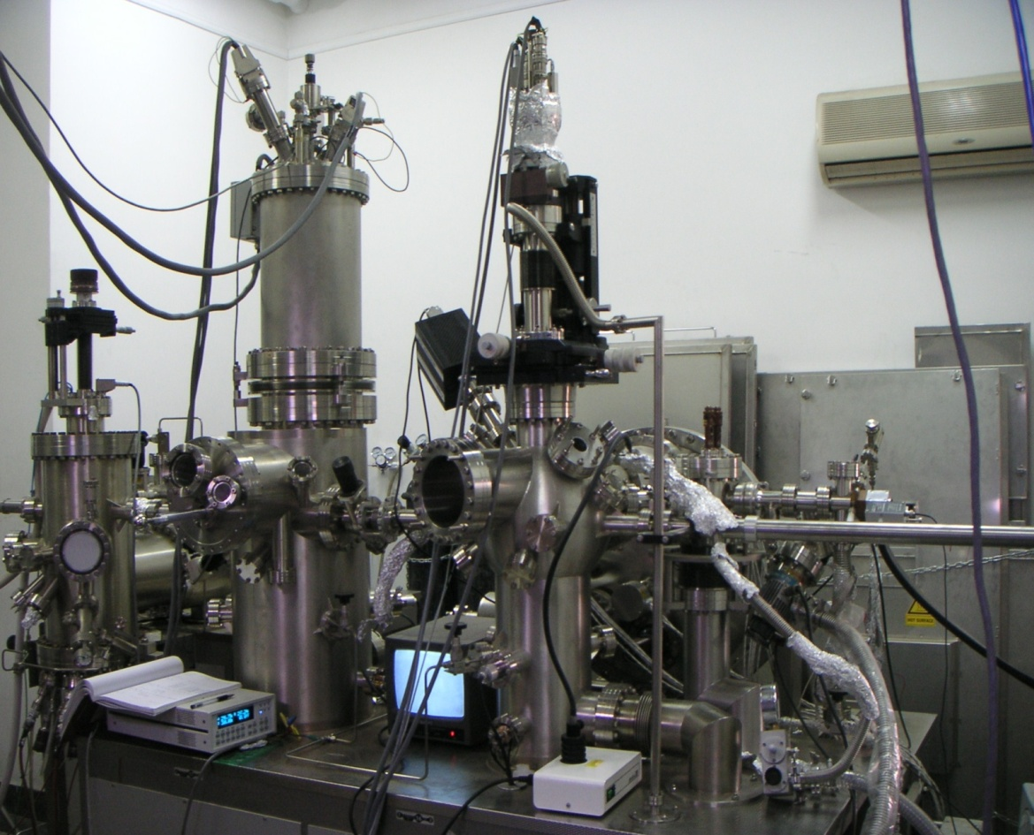
UHV MBE-STM-ARPES
Omicron + VG Scienta
STM
ARPES
MBE

Slide 14
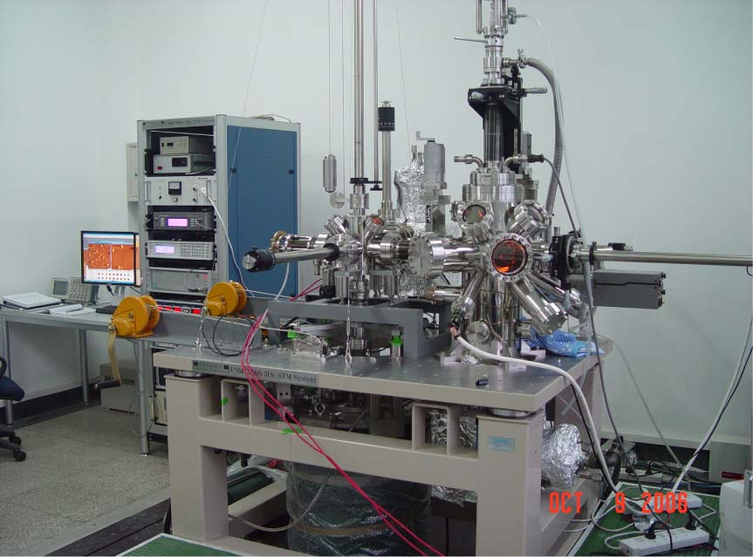
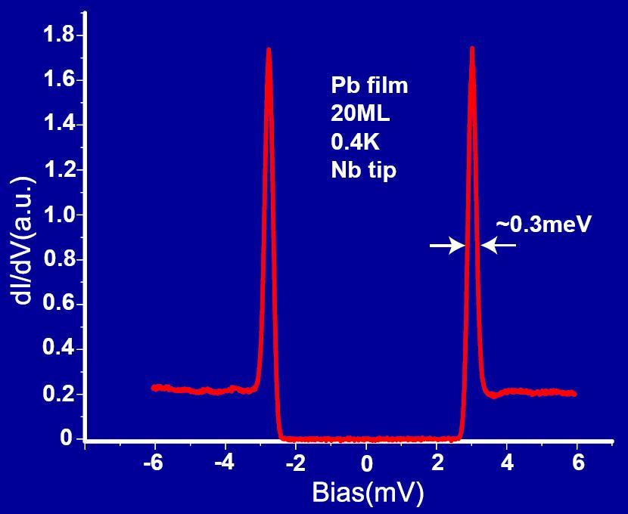
UHV LT High-Magnetic Field STM-MBE
T: 400 mK, B: 11 T
UHV: 5x10⁻¹¹ Torr
Unisoku
20ML Pb
Ji etal., PRL 100, 226801 (2008)
Chen et al., PRL 101, 197208 (2008)
Fu et al., PRL 103, 257202 (2009)
Zhang et al., PRL 103, 266803 (2009)

Slide 15
OUTLINE
Introduction
MBE growth of topological insulators
Quantum Anomalous Hall Effect
New developments and summary

Slide 16
Growth Kinetics
GaAs = Ga + As₄
Bi₂Se₃ = Bi + Se_{2/4}
GaAs
Bi₂Se₃
(Bi₂Te₃)
As-rich:
As₄/Ga>30
Se-rich:
Se_{2/4}/Bi>20
T_{Ga} > T_{Sub} > T_{As}
T_{Bi} > T_{Sub} > T_{Se}
Qi-Kun Xue et al., Phys. Rev. Lett. 1994, 1995
Qi-Kun Xue and T. Sakurai, MBE-STM of III-V Compound Semiconductors, Progress in Surface Science 57, 1-132 (1997)

Slide 17
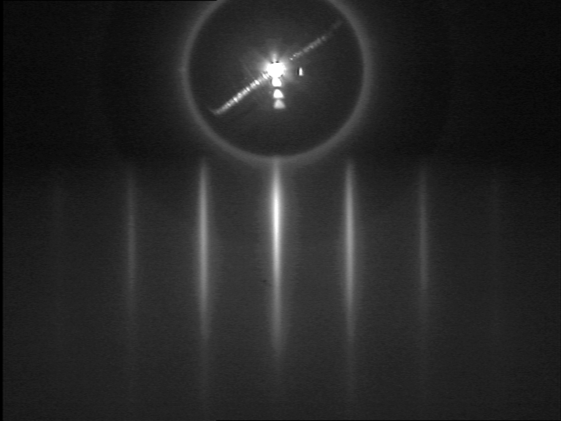
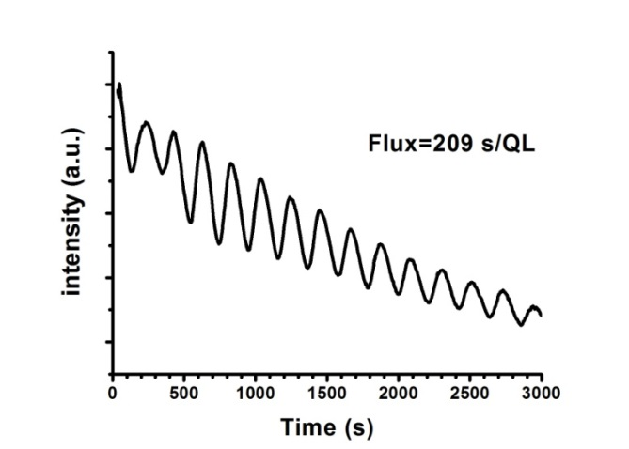
Establishment of MBE growth conditions
Y. Y. Li et al., Adv. Mater. 2010
High VI (Se) flux
Bi₂Se₃:
T_{Bi} >> T_{Sub} > T_{Se}
Stoichiometric: low impurities
Layer-by-layer: flat & single crystalline
Real time RHEED intensity oscillation
1QL
RHEED
Notes:
By optimization of the growth conditions, we could be able to achieve LBL growth of the films, as evidenced by the real-time oscillation. One circle of oscillation corresponds to one atomic layer growth, like this.

Slide 18

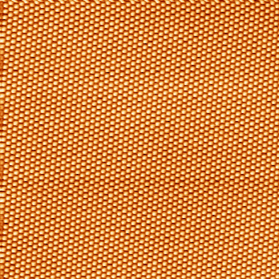
STM: atomically flat Bi₂Se₃ films on graphene
200 nm x 200 nm
-120mV
50 QL
Yi Zhang et al., Nature Physics 6, 584 (2010)

Slide 19
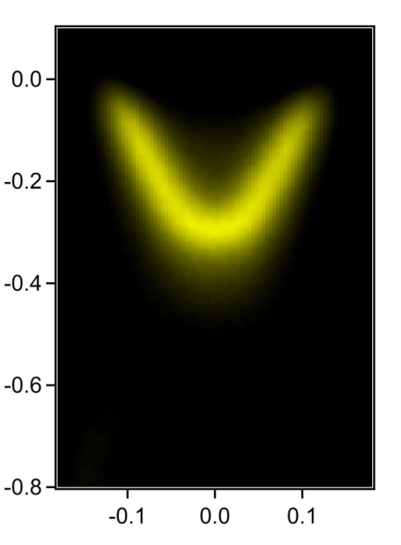
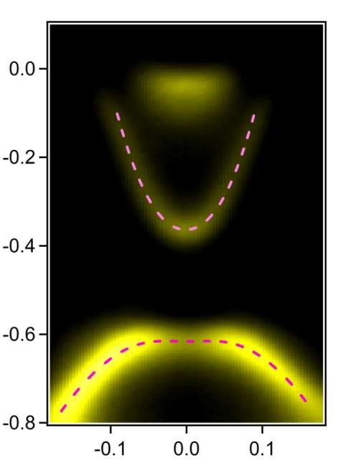
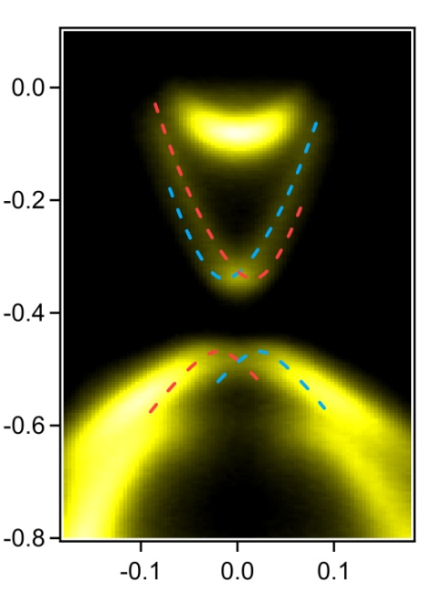
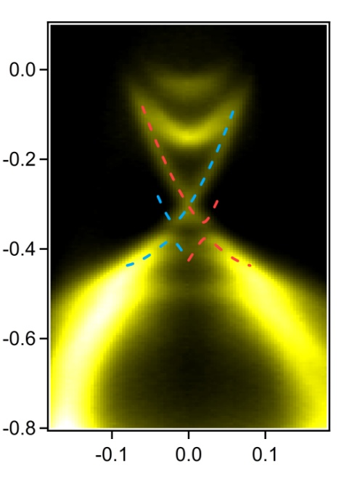
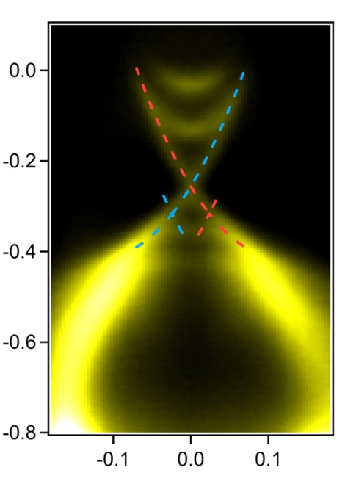
Bi₂Se₃ Band Structure: layer-by-layer
Figure 2
Yi Zhang et al., Nature Phys. 6, 584 (2010)
E_{F}
Binding Energy (eV)
6 QL
1 QL
2 QL
3 QL
5 QL
1QL
k// (Å⁻¹)
k// (Å⁻¹)
k// (Å⁻¹)
k// (Å⁻¹)
k// (Å⁻¹)
The thickness and band structure can be controlled with atomic-layer precision by MBE
Applied to FeSe, MoSe₂ and other layered materials
Critical thickness

Slide 20
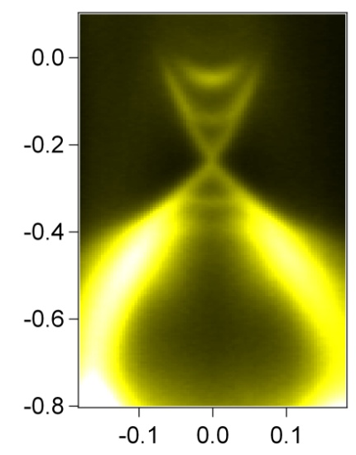
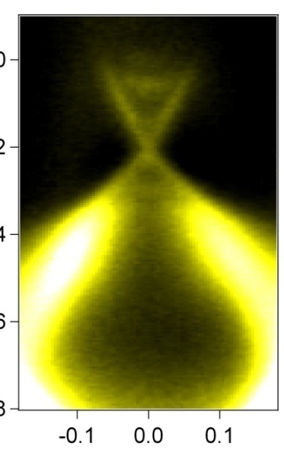
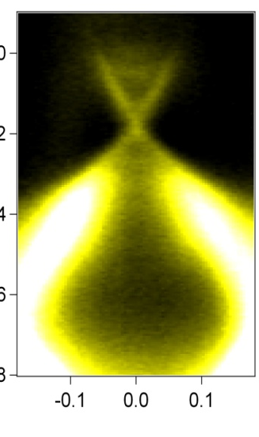
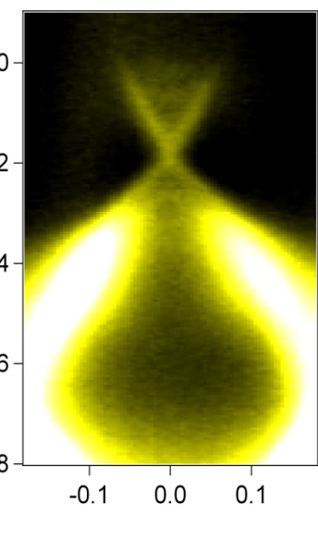
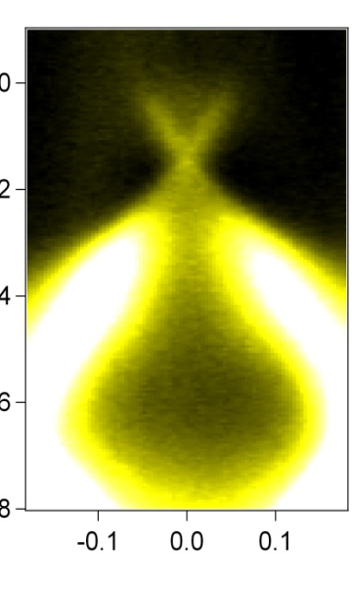
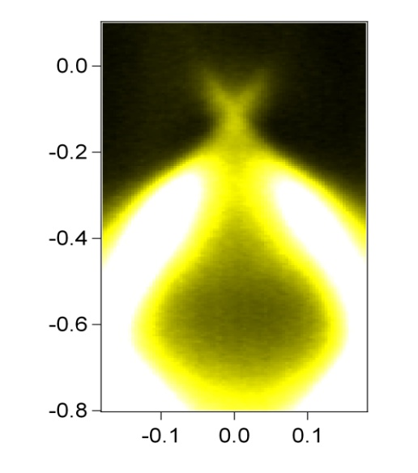
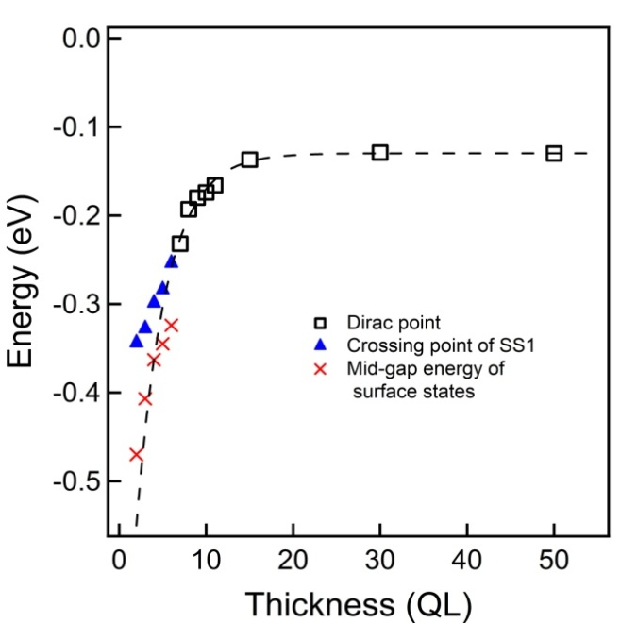
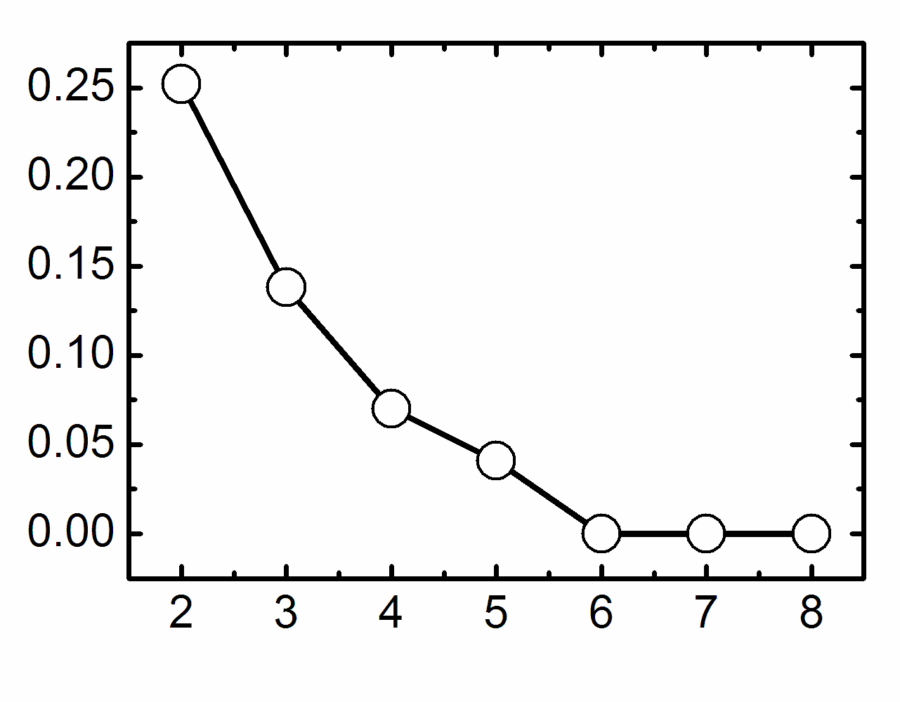
APRES test for thin Bi₂Se₃ film grown on graphene SiC surface
E_{F}
Binding Energy (eV)
7QL
8QL
9QL
10QL
15QL
k// (Å⁻¹)
k// (Å⁻¹)
k// (Å⁻¹)
k// (Å⁻¹)
k// (Å⁻¹)
E_{F}
Binding Energy (eV)
50QL
Gap size
k// (Å⁻¹)
Position of Dirac Point

Slide 21
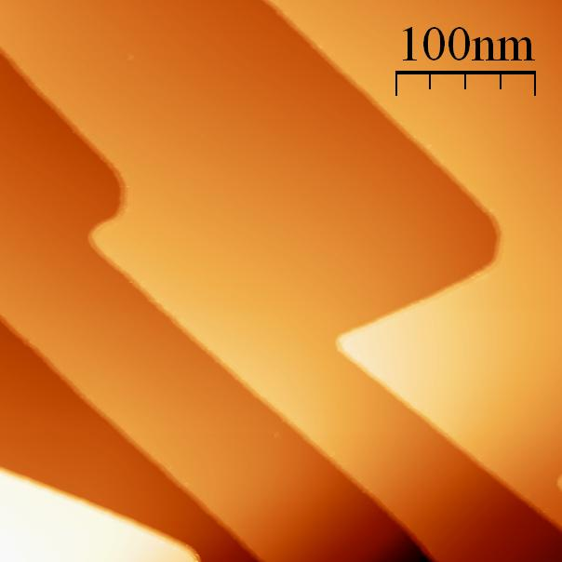
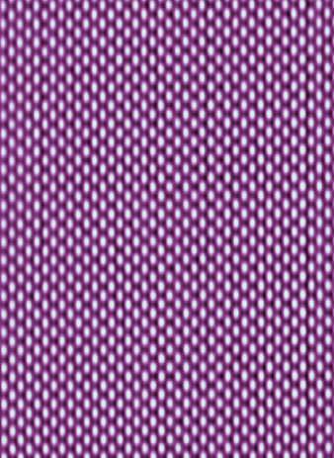
STM: atomically flat Bi₂Te₃ films
Te atom
16 nm x 16 nm
Y. Y. Li et al., Adv. Mater. (2010)
G. Wang et al., Adv. Mater. (2011)
X. Chen et al., Adv. Mater. (2011)
Notes:
The STM images demonstrate the atomically flat property of our films. In 200x200, only three atomc steps can be seen. From the high resolution image here, we can see individual Se atoms. Clearly there are very few defects, compared with previous study.

Slide 22
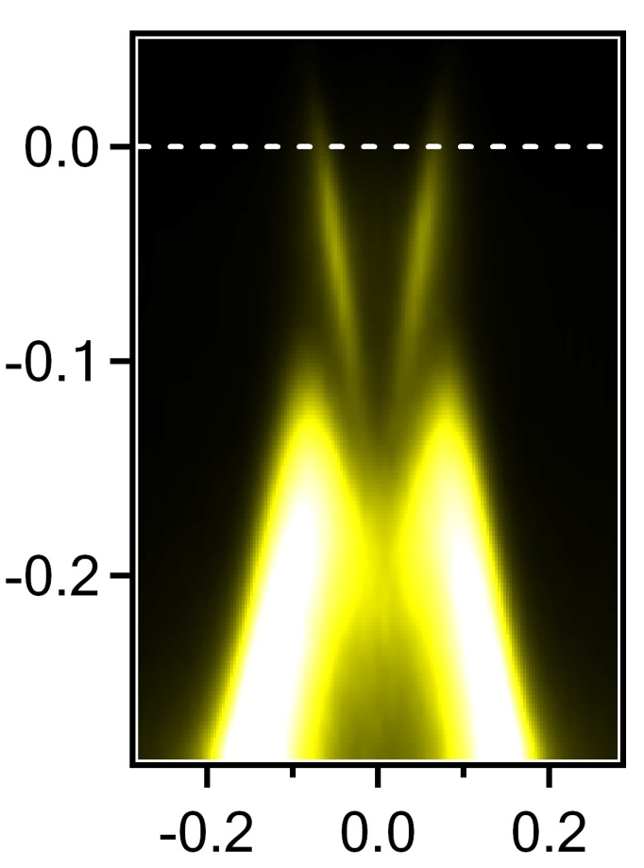
ARPES: Bi₂Te₃ band structure
E_{F}
E
Experimentally confirmed：
Massless Dirac Cone
Bi₂Te₃
k_{x}
k_{y}
Si substrate
Insulating topological insulator

Slide 23

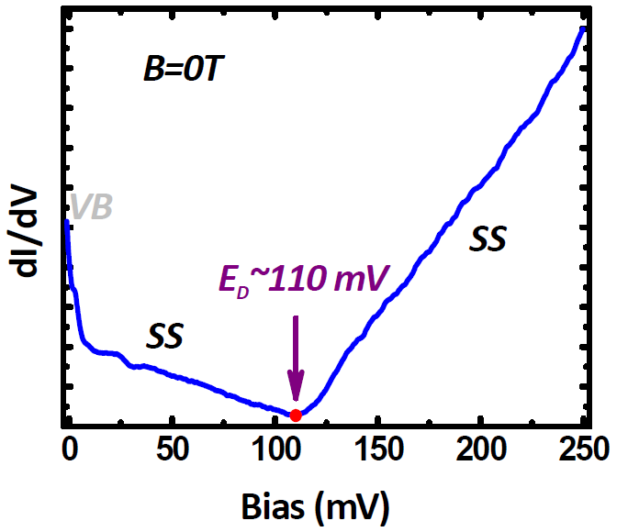
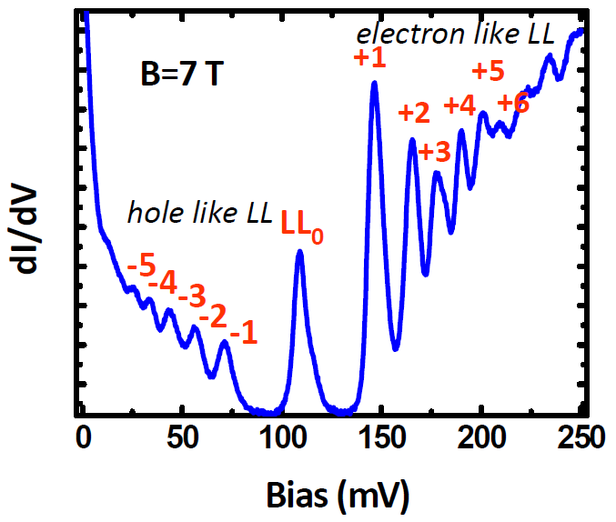
Sb₂Te₃
0.5 μm x 0.5 μm
Y. P. Jiang, PRL 108, 016401 (2012)
Y. P. Jiang PRL 108, 066809 (2012)

Slide 24




STM study of fundamental properties of TIs
Quantum Interference
Absence of backscattering
Zhang et al., PRL 103, 266803 (2009)
Jiang et al., PRL 108, 016401 (2012)
10
Massless Dirac fermion
(Landau Quantization)
1
11
8
9
12
B = 10T
2
3
4
5
6
7
Cheng et al., PRL 105, 076801 (2010)
0
Jiang et al., PRL 108, 066809 (2012)
Chang et al., PRL 115, 066809 (2015)
New TIs
Song et al., PRL 114, 176602 (2015)

Slide 25
We were able to prepare high quality epitaxial thin films of topological insulators by MBE
Notes:
Different from most people here, my group use MBE combined STM and ARPES on two very important directions in condensed matter physics: topological insulator and high temperature superconductivity.
IN THIS TALK, I would show you the experimental observation of quantized anomalous Hall effect, means quantum Hall without magnetic field, and interface enhanced superconductivity with a Tc most likely higher than 77K, which is very exciting.

Slide 26

Band structure of pure Bi₂Te₃ or Sb₂Te₃
E_{F}
E_{F}
E_{F}
Bi₂Te₃
Sb₂Te₃
Bi₂Te₃ + Sb₂Te₃
Bi₂Te₃: n-type, DP in valence band
DP at gap
Bulk insulating
Sb₂Te₃: p-type, DP in gap
Notes:
First 3D TI Bi0.9Sb0.1
Question: is any arbitrary alloy also a TI? Is it is true, how the Dirac surface band evolve with alloying

Slide 27

Band engineering of (Bi_{1-x}Sb_{x})₂Te₃
n to p transition
1. The band topology is preserved in all compositions
2. Charge neutral point (D_{P} = E_{F}): x = 0.95 (Sb)
J. S. Zhang et al., Nat. Commun. 2, 574 (2011)

Slide 28
High quality material
Correct Band structure
(Bi_{x}Sb_{1-x})₂Te₃
bulk insulating
ferromagnetic topological insulator

Slide 29

Resistivity vs Doping
Si: Δ =1.14 eV
Diamond
Nickle oxide
(Bi_{0.1}Sb_{0.9})₂Te₃: Δ < 0.15 eV
Glass
Silver bromide
One dopant/impurity per 10⁶ atoms
Intrinsic
Ultra-pure
10⁴
One donor per billion Si atoms
10²
10⁵ to 10⁻² Ω⋅cm
10⁰
10⁻²
One donor per million Si atoms
Heavily doped
Gold
Siliver, Copper
Queisser and Haller, Science 1998
Notes:
In this slide, I give a comparison between semiconductor and superconductor, in terms of the material quality. Taking Si, the most advanced semiconductor material, as an example. Now one can achieve crystal quality with defect density as low as 10^(3 to 4) out of the bulk density of 10^(23). One can purify the material up to 10 nines easily. Equally importantly, one can control the doping concentration very very precisely. The right panel gives the resistivity of Si as a function of doping level, published in Science in 1998 by these two authors. Here is diamond, which is very insulating and has a resistivity of 10^(14) Ohm-centimeter. Here is gold, the best conductive metal, which has a resistivity of 10^(-6).
For intrinsic Si without doping, the resistivity is 10^(5). As you can see clearly here, only by doping one carrier per million Si atoms, the resistivity drops to 10^(-2), change by seven orders of magnitude.
Such kind quality and such kind control account for the big success of Si semiconductor technology, which you can find in every computer of you.

Slide 30
OUTLINE
Introduction
MBE growth of topological insulators
Quantum Anomalous Hall Effect
New developments and summary

Slide 31


Magnetic doping
J. S. Zhang et al., Science 339, 1582 (2013)
Cr/Fe doped Bi₂Se₃ (Δ = 0.30 eV)
Yu et al., Science 329, 61 (2010)
WL-WAL
Cr: 11%
paramagnetic
Topology-driven quantum magnetic phase transition

Slide 32
QAHE: growing insulating ferromagnetic TIs
Cr doping of (Bi,Sb)₂Te₃
Te
Bi(Sb)
Cr substitutes Bi(Sb)
not introduce additional carriers: insulating
No Cr clustering (Mn-GaAs)
Correct Cr concentration
Te
Bi(Sb)
Te
1 QL
(1.0 nm)
too little: no FM ordering
too much: destroy band topology

Slide 33


Low temperature MBE growth of (BiSb)₂Te₃ and Cr doping at 180 °C
1. Cr at Bi or Sb site
2. no Cr clustering
C. Z. Chang et al., Adv. Mater. 2013

Slide 34


Magnetic property: independent of doping
Chang et al., Adv. Mater. 2013
0
Curie temperature (K)
Bi content (x)
Ferromagnetic phase (even at zero carrier density)
van Vleck mechanism?……
J. Y. Zhu: different explanation

Slide 35


Quantum Anomalous Hall Effect in Cr_{0.15}(Bi_{0.1}Sb_{0.9})_{1.85}Te₃
C. Z. Chang et al., Science 340, 167 (2013)
experiment
theory
h/e²
At different gate voltage, nearly no change in the shape and coercivity.
(van Vleck mechanism)
2. ρ_{yx} is nearly independent of H.
(perfect ferromagnetic ordering and charge neutrality)
3. At -1.5V, ρ_{yx} = h/e²
30 mK
H
-1.5 V
0
20 samples at T = 1.5 K
6 samples at T = 90 mK (zero-field ρ = 0.87 to 0.98 h/e²)
2 samples at T = 30 mK (full quantization at h/e²)
-55 V
0 V
220 V
Notes:
Left figure shows Hall sheet resistance as function of magnetic field perpendicular to the film.

Slide 36
Confirmation of QAHE
2014.08： Tokyo/RIKEM
2014.09：UCLA
2015.03：MIT
2015.05: Stanford
2016.06: Princeton
2017.06: Wurzburg

Slide 37
Completion of the quantization of all Hall effects
R_{H}
R_{H}
R_{H}
h/e²
h/2e²
R_{H}=3h/e²
Half-integer
QHE
(graphene)
FQHE
(GaAs)
H
H
H
Hall Effect
Anomalous HE
IQHE (Si)
TPM
IQHE
FQHE
1879
1881
1980
1982
1983
2005
2010
1985
1998
E. Hall
K. von Klitzing
B. Laughlin
H. Stormer
D. Tsui
R_{H}
h/e²
H
D. Thouless
F. Haldane
J. Kosterlitz
QAHE
Cr_{0.15}(Bi_{0.1}Sb_{0.9})_{1.85}Te₃
2016
2013
Topological Phase Transitions & Topological Phases of Matter

Slide 38




Slide 39



April 12, 2013

Slide 40
OUTLINE
Introduction
MBE growth of topological insulators
Quantum Anomalous Hall Effect
New developments and summary

Slide 41
QAHE: < 50 mK
Temperature: a key factor for applications
Magnetic proximity
Higher quality TI materials
Co-doping or other dopants
……
Notes:
Later the QAHE was also observed by other groups. But for all the experiments the temperature required to observe full quantization is below 100 K. So such a low temperature is needed? To answer the question, we can check the factors determining the QAHE. 。。。。Actually all the factors can be tuned by the thickness of magnetic TI films. So we may find the key factor determining temperature of the QAHE by studying thickness dependence of the QAHE.

Slide 42
“Penta-layer” Cr-doped (Bi,Sb)₂Te₃
Y. Tokura: APL 107, 182401 (2015)
Good quantization
at 0.5 K and zero field
Notes:
Actually, recently, Tokura group reports an increase of the QAH temperature in so-called pentalayer structure. It is essentially a sandwich structure with heavily Cr doped (Bi,Sb)2Te3 as FMI layers.

Slide 43
Quantized Anomalous Hall Effect in V-Sb₂Te₃
MIT/PSU/Stanford
V-doped Sb₂Te₃
(~4%)
25 mK
Dr. Chang and Prof. Moodera (MIT)

Slide 44
Cr & V co-doped (Bi,Sb)₂Te₃ films
5 QL (Cr_{y}V_{1-y})_{0.19}(Bi_{x}Sb_{1-x})_{1.81}Te₃
@ 1.5 K
Cr:V
Notes:
Very recently we found that by co-doping V and Cr, we can increase the QAH temperature. Left side is Cr doped, and right side is V-doped. We can see that at an optimized Cr:V ratio, we can get rho_yx of 0.97 h/e² at zero magnetic field at 1.5 K.

Slide 45
Full quantization at 0.3 K
a
b
Y. B. Ou et al., APL Materials 4, 086101 (2016)
Notes:
At 0.3 K, we get perfect quantization (rho_xx is below 200 Ohm)

Slide 46




Z. Y. Zhang, S. B. Zhang, E. Kaxiras: Phys. Rev. Lett. 117, 056804 (216)
V and I coped Sb₂Te₃
T = 50 K
Notes:
Next we shall consider to develop QAH-based QAH devices. The first step is to control, for example to turn on/off the chiral edge states with magnetic or electrical way. Since QAH phase is determined by ferromagnetism the magnetic way is easier.
If we could control the relative magnetization of the top and bottom surfaces we can turn on/off the edge states. In parallel configuration we get the QAH phase. In anti-parallel configuration the edge states will be turned off. It is actually a so-called axion insulator phase.

Slide 47





Creating Majorana modes in TIs
γ = γ†
Majorana zero modes: spin-selective Andreev reflection
Bi₂Te₃
NbSe₂
Xu et al., PRL 114 017001 (2015)
Sun et al., PRL 116 257003 (2016)
Chiral Majorana fermion modes at the edge
$$0.5\frac{e^{2}}{h}$$
QAHI: (Cr_{0.12}Bi_{0.26}Sb_{0.62})₂Te₃
Qing-Lin He et al., Science 357, 294 (2017)

Slide 48

Topological spin valve for QAH edge states
Parallel alignment of the magnetizations of two surfaces
Anti-parallel alignment of the magnetizations of two surfaces
heavy V-doping (5QL)
Non-doped (3QL)
Heavy Cr-doping (5QL)
0.5 Mega Ohm
Off state
On state
See also: Mogi et al., Nat. Mater. 16, 516 (2017)
Notes:
So we realize such a topological spin-valve with co-doped (Bi,Sb)2Te3 (co-doped films have sharper magnetization reversal, which is good for such a spin-valve structrue). The top surface is a 5 QL co-doped film with more V atoms, which has larger coercivity. The bottom surface is a 5 QL co-doped film with more Cr atoms, which has smaller coercive fields. The top and bottom films are separated by a 3QL non-doped (Bi,Sb)2Te3, which decouple their magnetization. We observed a perfect “zero plateau” due to anti-parallel alignment of the magnetizations of the two surfaces. The “off state” has a resistance over 20 h/e^2 (~0.5 Mega Ohm) and the “one state” has a resistance of zero. (the feature around zero field in the lower right panel may come from magnetization reversal of some small magnetic domains. )

Slide 49
Summary
QAHE has been confirmed
QAHI exhibits many novel properties to be explored

Slide 50
Acknowledgements
Group Members:
Ke He, Xucun Ma, Lili Wang, C. L. Song, D. Zhang, X. Chen, S. H. Ji
Jinfeng Jia (Shanghai Jiao-Tong Univ.)
Transport: Yayu Wang (Tsinghua), Li Lv, Y. Q. Li (IOP)
Jian Wang (PKU)
Theory:
Shoucheng Zhang (Stanford), Bangfen Zhu, Wenhui Duan (Tsinghua), Z. Fang, X. Dai (IOP), X. L. Qi (Stanford), C. X. Liu (Penn State), Shengbai Zhang (RPI), X. C. Xie (PKU), S. Q. Shen (Hong Kong), Feng Liu (Utah)
$$$: NSF, MOST, MOE of China, CAS

Slide 51
Thank you very much!

